Slide 1
CSCIU 210 Computer Organization AKM Jahangir A Majumder, PhD
Fall 2018 - Lecture 23
October 24, 2018
Note: Some slides are adapted from those used by previous instructors and some slides include figures from the textbook.

Slide 2
Review and Learning Outcomes
We finished our coverage on how to do simple ALU design
Will continue to cover:
Registers in a MIPS Computer
A Simple Processor Diagram
MIPS Assembly Language
We will have Quiz 5 on Friday, November 2, which will cover lecture 20-24
HW 5 will post on Blackboard soon, which is due on Wednesday, October 31

Slide 3
Review: Registers consisting of D Flip-Flop
D₀
D₁
D₂
D₃
D
D
D
D
Q
Q
Q
Q
C
C
C
C
Clock

Slide 4
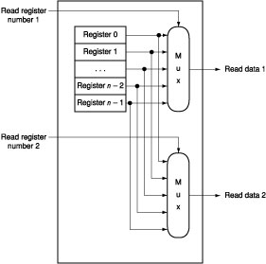
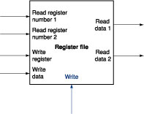
Reading data from Register File
Built using D flip-flops
What is the “Mux” above?

Slide 5
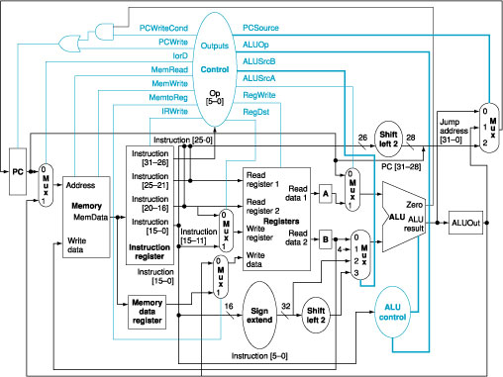
Registers in a MIPS Computer
register
file

Slide 6
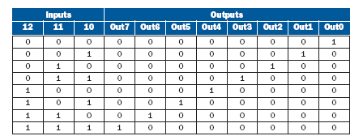
Review: Function of a Decoder
3 bit
decoder
Out 0
Out 1
I0
Out 2
I1
Out 3
I2
Out 4
Out 5
Out 6
Out 7

Slide 7
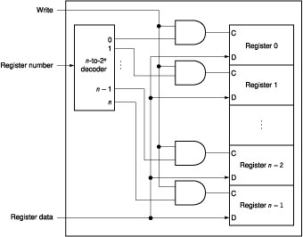
Writing data into Register File
Note: We still need the clock signal to determine when to write data into register.

Slide 8
Clocks
Signals to control timing
Ensure values are not used during transitions
State elements store values between stages
State element (Latch)
State element (Latch)
Combinational Logic
Combinational Logic
Input
Output
Clock

Slide 9
Critical Path & Cycle Time
Clk
.
.
.
.
.
.
.
.
.
.
.
.
Critical path: the slowest path between any two storage devices
Cycle time is a function of the critical path
must be greater than:
Clock-to-Q + Longest Path through Combination Logic + Setup
Notes:
If you follow this simple clocking methodology which uses the SAME clock edge for all storage devices, the critical path of your design is easy (well at least in theory) to identify.
More specifically, the critical path of your design is the slowest path from one storage device to another through the combination logic.
The cycle time of your design is a function of this critical path, or more specifically, the cycle time must be greater than the sum of:
(a) The Clock-to-Q time of the input register.
(b) The longest delay through the combination logic.
(c) And the Setup time of the next register.
The key words here are “greater than” because if you set the clock cycle time to this, chances are things will work most of the time but will fail occasionally-usually it will fail when you have to run your demo to you customers.
The additional thing you need to worry about is clock skew.
That is due to different delay on the clock distribution network, the two storage devices may end up seeing two slightly different clocks.
+3 = 65 min. (Y:45)

Slide 10
Tricks to Reduce Cycle Time
Reduce the number of gate levels
A
A
B
B
C
D
C
D
Pay attention to loading
One gate driving many gates is a bad idea
Avoid using a small gate to drive a long wire
Use multiple stages to drive large load
INV4x
C_{large}
INV4x
Notes:
Here are some common tricks you can use to reduce the cycle time.
The most obvious way is to reduce the number of logic levels.
Then you should also pay attention to loading. That is you should:
(a) Avoid using one small gate driving a large number of other gates.
(b) Also avoid using a small gate to drive a long wire.
Whenever you have to drive a large capacitance, you should use multiple stages to drive it.
(c) take advantage of the difference between the type of gate and choice of active high or low signaling convention.
(d) advanced circuit design techniques such as dynamic circuitry and precharging.
(e) “cycle stealing”.
+1 = 69 min. (Y:49)

Slide 11
Clock Skew’s Effect on Cycle Time
Clk1
Clk2
Clock Skew
.
.
.
.
.
.
.
.
.
.
.
.
The worst case scenario for cycle time consideration:
The input register sees CLK1
The output register sees CLK2
Cycle Time > CLK-to-Q + Longest Delay + Setup + Clock Skew
Notes:
Let’s look at an example here.
Consider the worst case scenario where the input register sees the clock signal Clock One.
Due to the different delay through different parts of the clock distribution network, the output register sees the clock signal Clock Two (CLK2).
Here (points to Clock Skew) I have shown you that Clock Two will arrive the output register Slightly earlier than Clock One arrives at the input Register.
Consequently, the minimum cycle time for this circuit to work is the sum of:
(a) The Clock-to-Q time of the input register.
(b) The longest delay path through the combination logic.
(c) The Setup time of the output register.
(d) And the purpose of this slide, the clock skew of the clock distribution network.
In your homework and lab assignments, you probably will be using a relatively slow clock so clock skew is probably not a big problem.
After you graduate, you may be lucky enough to find a job to work on some very high speed digital design, then the Clock Skew can be a major problem. (clock skew is usually kept <10% of the cycle time in very high speed system).
In those high speed designs, if you are not careful, the sum of the Clock-to-Q time, the Setup time, and the Clock skew can become a major part of your cycle time.
Notice that, if your Flip Flops have lousy Clock-to-Q and Setup times and your clock distribution is so poorly design that clock skew is big, then even if you can have the fastest logic gates in the world, you still will not have a super fast design.
You can slow down the clock to “fix” a setup violation; there is not a whole lot you can do about hold time problem!
+3 = 68 min. (Y:48)

Slide 12
Review: Function of a Multiplexer
4-1 multiplexer
S₀ | S₁ | Y
0 | 0 | I₀
0 | 1 | I₁
1 | 0 | I₂
1 | 1 | I₃
I₀
Mux
I₁
Y
I₂
I₃
₂
s

Slide 13
Building of 4-to-1-line Multiplexer with a Decoder
2-to-2²-line decoder
2² × 2 AND-OR

Slide 14
Function of a Demultiplexer
1-4 demultiplexer
S₀ | S₁ | O₀ | O₁ | O₂ | O₃
0 | 0 | In | 0 | 0 | 0
0 | 1 | 0 | In | 0 | 0
1 | 0 | 0 | 0 | In | 0
1 | 1 | 0 | 0 | 0 | In
DeMux
O₀
In
O₁
O₂
O₃
₂
s

Slide 15
Building of 1-to-4-line Demultiplexer with a Decoder
O₀
In
O₁
O₂
O₃

Slide 16
Actually, We Already Covered the Demultiplexer

Slide 17
Our Simple Processor Description
We will use the logic components we learned so far to build a processor.
The processor have 16 registers and one ALU with 8 functions.
The processor can conduct the following functions:
Conduct an ALU function with two registers as inputs and output the ALU result to a specified register.
Write data into a register.

Slide 18
A Simple Processor Diagram
clock
Mux 1
A
L
U
0
Mux 2
Mux 3
1
Data In
load
des_regad
regad2
regad1
aluop
Note: n=16

Slide 19
Machine Format
Our processor’s machine code format is given below
[load, regad1, regad2, des_regad, aluop]
load signal: 1 (read from external input), 0 (read from ALU)
regad1: the address of the register for the ALU input 1
regad2: the address of the register for the ALU input 2
des_regad: the address of the destination register which data is written into
aluop: the ALU function selection
There are 16 registers and 8 ALU functions.
Question: Based on the above description of the processor, how many bits each command should have?

Slide 20
Register and ALU Function Numbering
Register numbering: r0 ~ r15
ALU functions:
 | ALU Function | Assembly Code
0 (000) | And | and
1 (001) | Or | or
2 (010) | NAND | nand
3 (011) | NOR | nor
4 (100) | XOR | xor
5 (101) | Addition | add
6 (110) | Subtraction | sub
7 (111) | Slt | slt

Slide 21
Conversion between Assembly Language and Machine Code
Assume the syntax of assembly language of our simple processor as following:
‘sub r3, r1, r2’ means: r1-r2⇒r3
‘slt r3, r1, r2’ means:
If r1<r2 ⇒r3 =1
Otherwise, r3=0
‘load r5’ means: external input data ⇒ r5
Example:
sub r3, r1, r2 ⇒ [0000100100011110]
slt r3, r1, r2 ⇒ [0000100100011111]
load r5 ⇒ [1XXXXXXXX0101XXX] (we assign all of ‘X’ equal to 0)

Slide 22
In-Class Exercise
Based on the processor description, translate the following assembly language into machine code [load, regad1, regad2, des_regad, aluop]:
and r6, r3, r4
add r2, r3, r6
load r7
 | ALU Function | Assembly Code
0 (000) | And | and
1 (001) | Or | or
2 (010) | NAND | nand
3 (011) | NOR | nor
4 (100) | XOR | xor
5 (101) | Addition | add
6 (110) | Subtraction | sub
7 (111) | Slt | slt

